Slide 1
Physic Simulator – Hardware Acceleration
David Lee

Slide 2
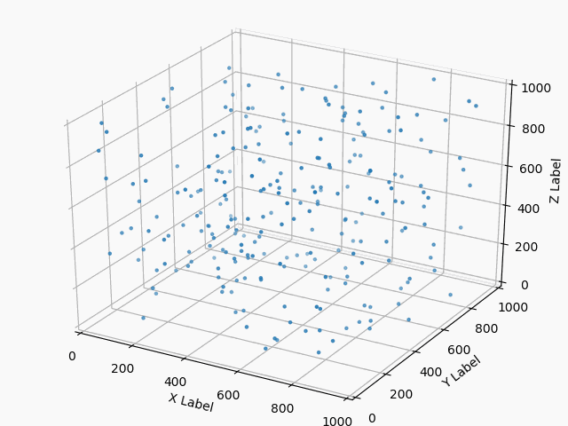
Physics Simulation
Create a physics simulator
Design space exploration – Hardware Acceleration of Floating Point Calculations

Slide 3
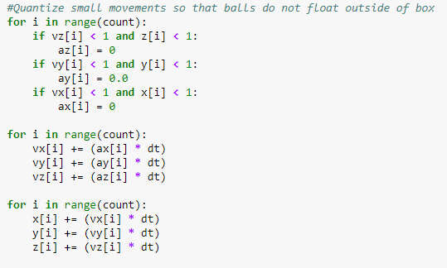
Update Loop
Quantize small movements
Update Velocity and Position of each particle
Check for Boundary Collisions
Check for Collisions with other particles

Slide 4
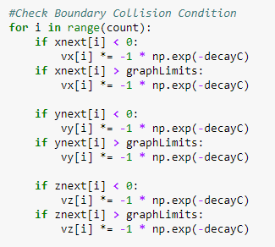
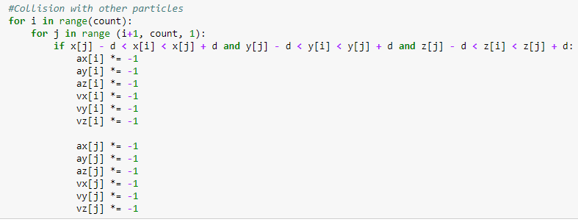
Update Loop (cont.)

Slide 5
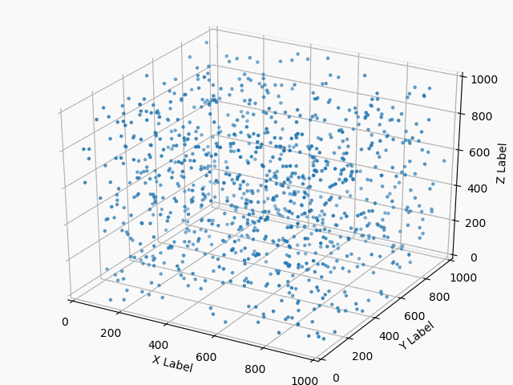
Observation
Desktop Run – 1000 Count
Physics simulation becomes more difficult to run, even on desktop
AXI Buses is cannot transfer floating point data types very easily
Even with 5 particles, Hardware Acceleration is extremely effective

Slide 6
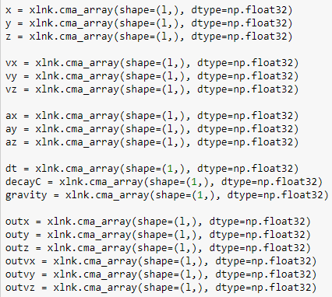
AXI Bus – Floating Point
Register Writing in PYNQ supports only np.uint32 and np.uint64
Must use m_axi4 protocol and fetch data from DDR
Floating point numbers must be initialized using nd array

Slide 7
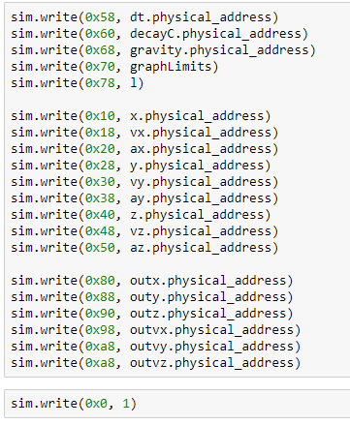
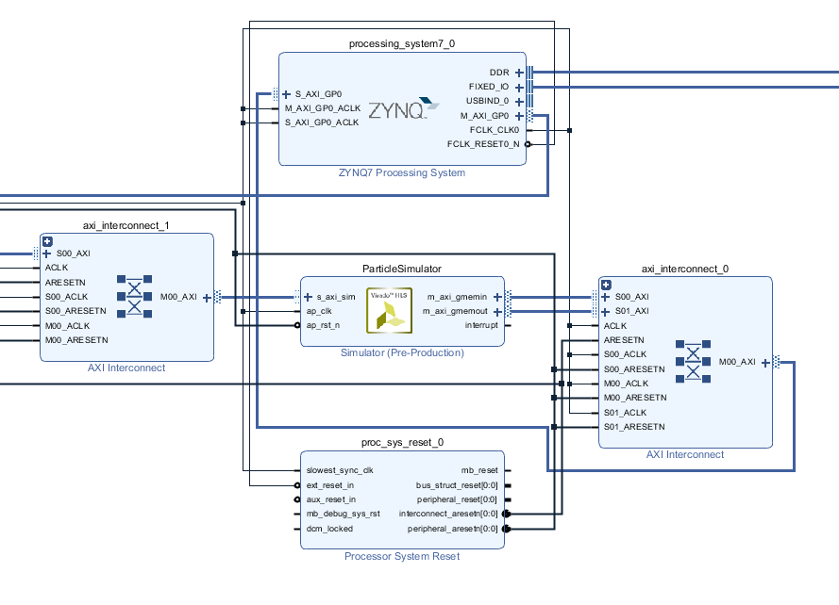
AXI Bus – Floating Point (cont.)

Slide 8
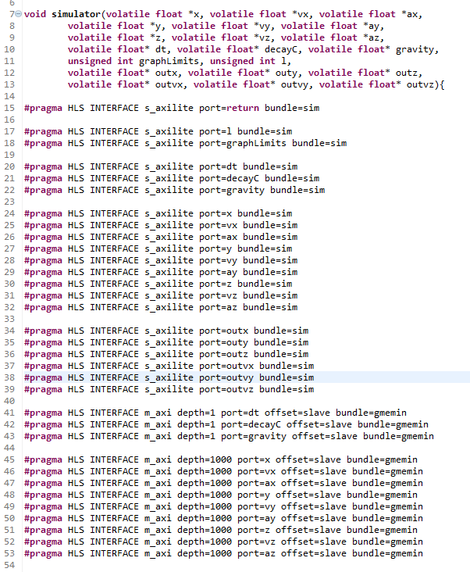
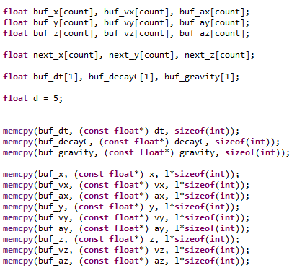
HLS Code

Slide 9
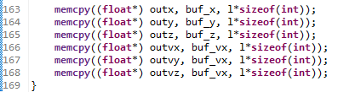
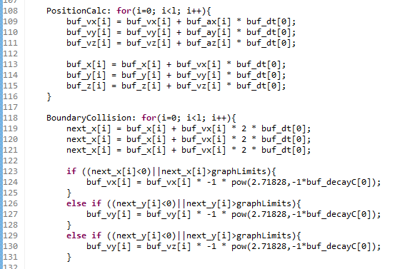
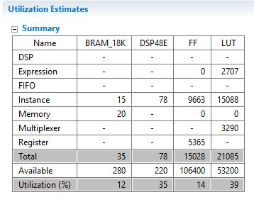
HLS Code (cont.)

Slide 10
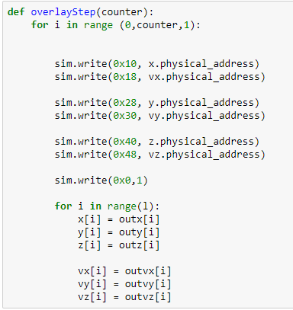
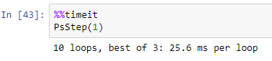
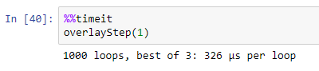
Hardware Acceleration Performance
No Hardware Acceleration
Hardware Acceleration

Slide 11
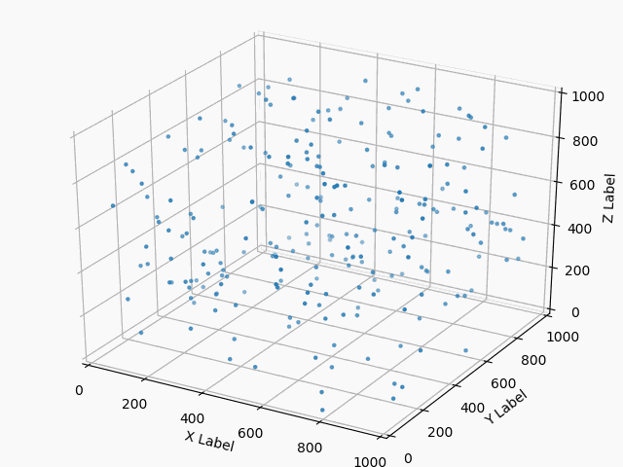
Future Work
Run Animation Loop with Hardware Acceleration
Raise particle count and compare speedups
Optimize HLS code
Loop Fission and Loop Fusion
Pipelining
Array’s

